Slide 1
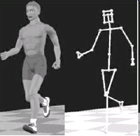
Chapter 3 Character animation

Slide 2
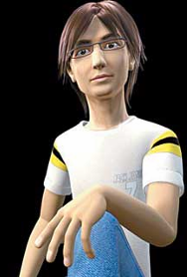
Content
Keyframe
Skeletal Animation
Motion capture
Motion Editing
Summary

Slide 3
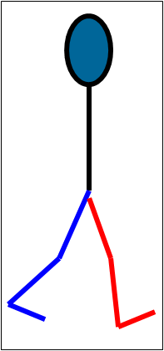
Keyframe Example

Slide 4
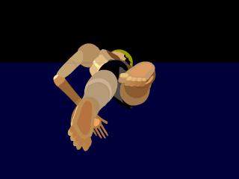
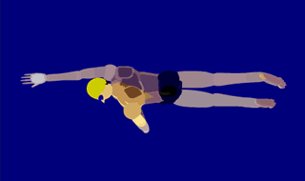
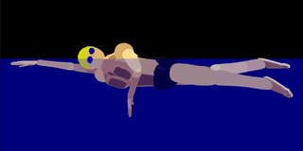
Keyframe Example

Slide 5
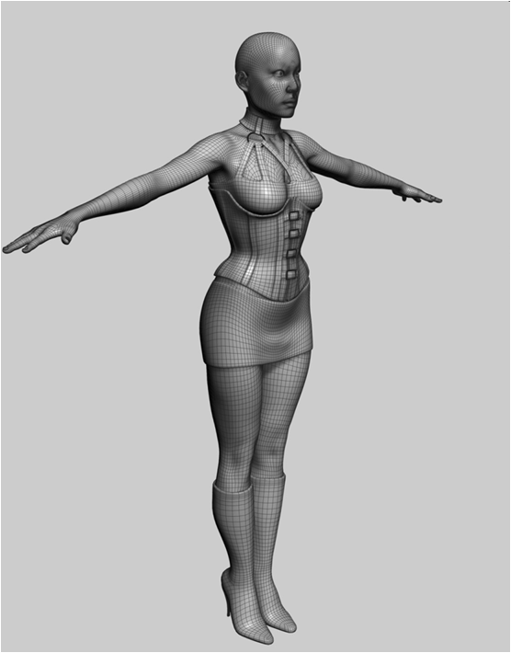
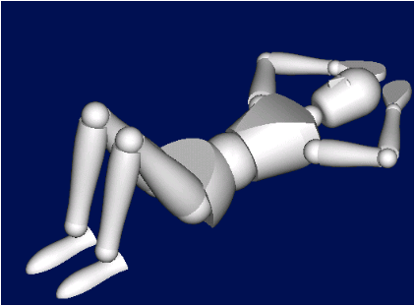
Keyframing
Fine level of control
Quality of motion depends on skill of animator

Slide 6
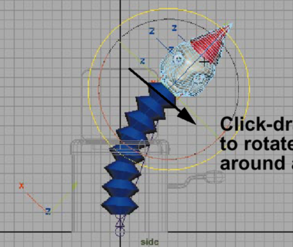
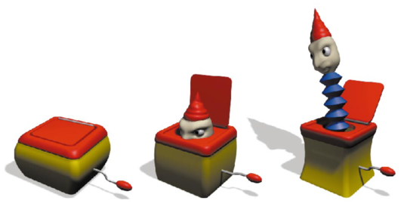
Key-framing (manual)
Requires a highly skilled user
Poorly suited for interactive applications
High quality / high expense
Limited applicability

Slide 7
Content
Keyframing
Skeletal Animation
Motion capture
Motion Editing
Summary

Slide 8
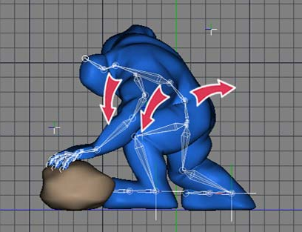
一、Character Animation
Key Frame or Motion Capture
Usually skeletal animation based
Two Components:
Skeleton motion
Skin move

Slide 9

一、Character Animation
Upper Arm
Lower Arm

Slide 10
一、Character Animation
y
x
Bone 2
y
x
x
y
Global

Slide 11
一、Character Animation
y
y
x
x
Bone 1
Bone 2
y
Coordinate system transformations
x
Global

Slide 12
虚拟手——实例
虚拟手的层次结构为1个手掌父节点和5个手指子节点，当手掌运动时（根据跟踪器的数据），所有子节点（手指）也随之运动
为了实现一个抓握手势，需要把每个手指再进一步细分为子结构，手指是第一指关节的父节点，第一指关节是第二指关节的父节点。而第二指关节又是末梢关节的父节点
使用来自传感手套的数据改变手指分段的位置，可以模拟出虚拟手的动作，这是通过改变手的树图结构中各个节点之间的变换矩阵T_{i←j}(t)实现的

Slide 13
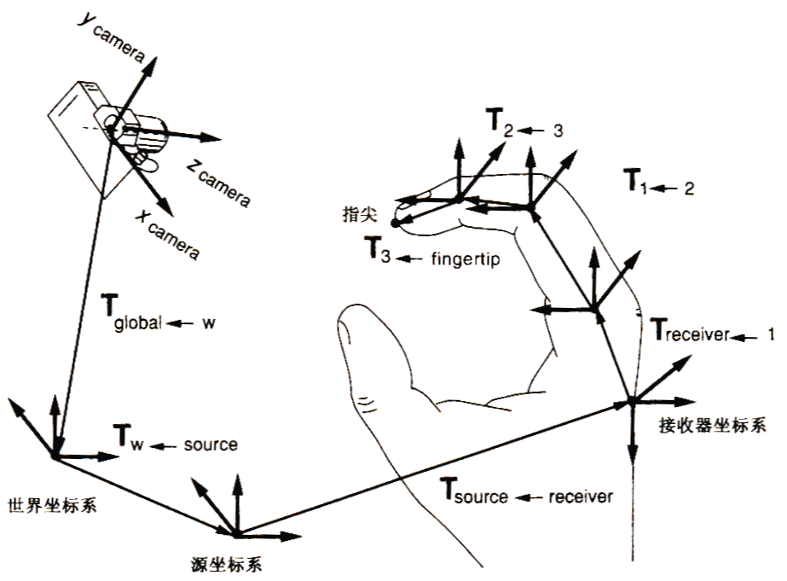
例：指尖在世界坐标系中的位置

Slide 14
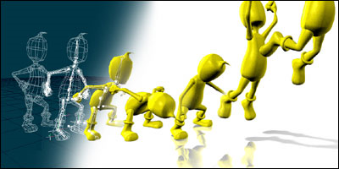
一、Character Animation
Skin motion
Represent vertices in bone coordinate systems
Move bone coordinate systems
Skeleton motion
Parameterized by the joint angles

Slide 15
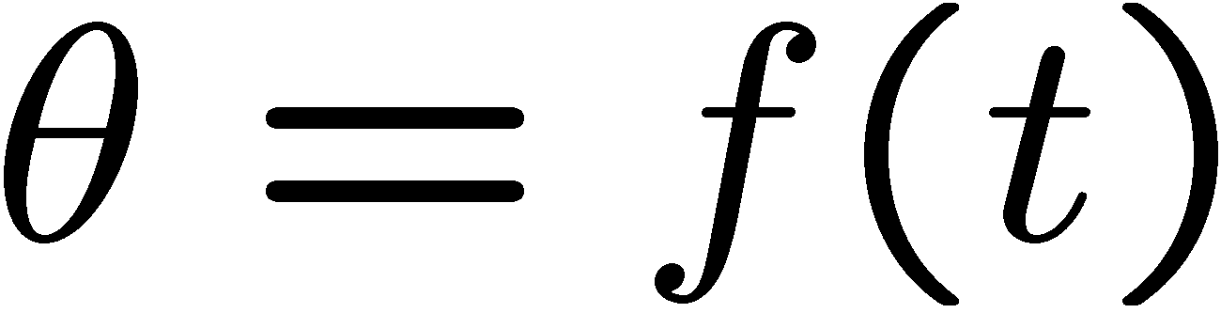

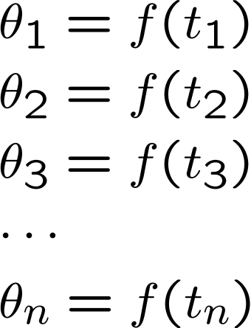
一、Character Animation
Skeletal motion is a function of time
Representing this function
t

Slide 16
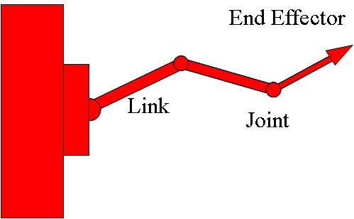
二、关节结构
关节链
一系列依次相连的刚体连接而成的开链
两刚体的连接点称为关节(joint)
连接两相邻关节的刚体称为连杆(link)
计算机动画中将关节限制为旋转关节，相邻刚体在其连接关节处只能做相对旋转运动，不能做平移运动
基结点和末端影响器(end effector)
关节链的起点为基结点
其自由末端为末端影响器

Slide 17
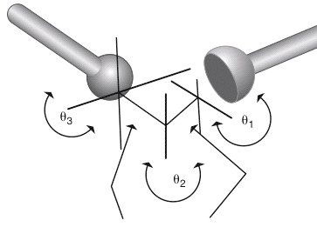
二、关节结构
自由度DOF(degree of freedom)，
完全确定关节链结构的状态所需的独立变量个数
无约束刚体的自由度为6
状态空间
定义关节链结构的所有可能形态的向量空间
其中每个向量定义了关节链结构的一种形态
由一组独立的位置、朝向及关节旋转等参数确定
状态空间的维数等于关节链结构的自由度 Θ=(x, y, z, θ, φ, ψ)
Notes:
Ψ ψ psi psai 普西

Slide 18
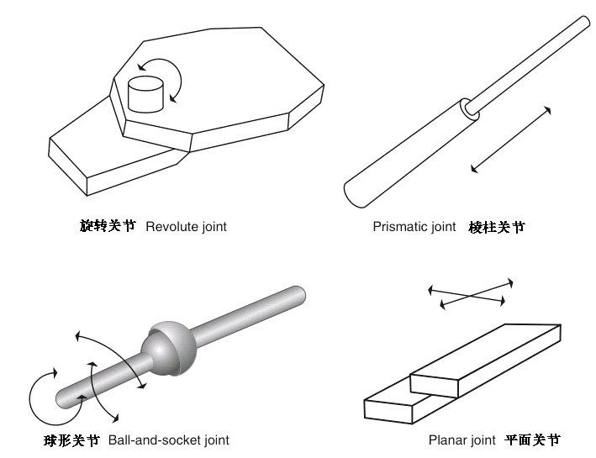
二、关节结构
关节的类型：
不同自由度的关节结构
1 DOF
3 DOF
2 DOF

Slide 19
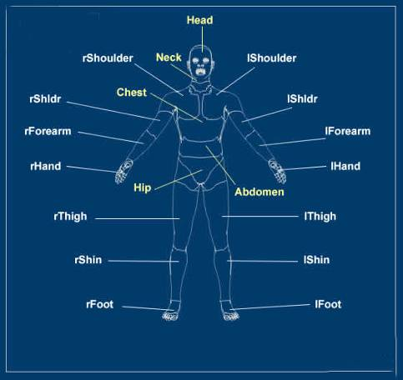
三、Human model

Slide 20
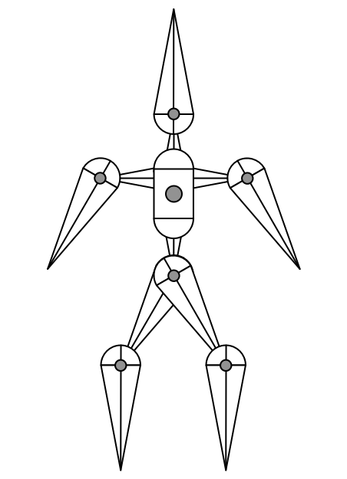
三、Human model
Articulated skeleton
Topology (what's connected to what)
Geometric relations from joints
Independent of display geometry
Tree structure
Loop joints break “tree-ness”
Notes:
Articulated：铰接的

Slide 21
三、Human model
Root body
Position set by “global” transformation
Root joint
Position
Rotation
Other bodies relative to root
Inboard toward the root
Outboard away from root

Slide 22
三、Human model
A joint
Joint's inboard body
Joint's outboard body

Slide 23
三、Human model
A body
Body's inboard joint
Body's outboard joint
May have several outboard joints

Slide 24
三、Human model
A body
Body's inboard joint
Body's outboard joint
May have several outboard joints
Body's parent
Body's child
May have several children

Slide 25
三、Human model
Interior joints
Typically not 6 DOF joints
Pin - rotate about one axis
Ball - arbitrary rotation
Prism - translation along one axis
Notes:
Prism: 柱

Slide 26
三、Human model
Tree structure
Hip
lThigh
Abdomen
rThigh
lShin
Chest
rShin
lFoot
lShoulder
Neck
rShoulder
rFoot
lShldr
Head
rShldr
lForearm
rForearm
lHand
rHand

Slide 27
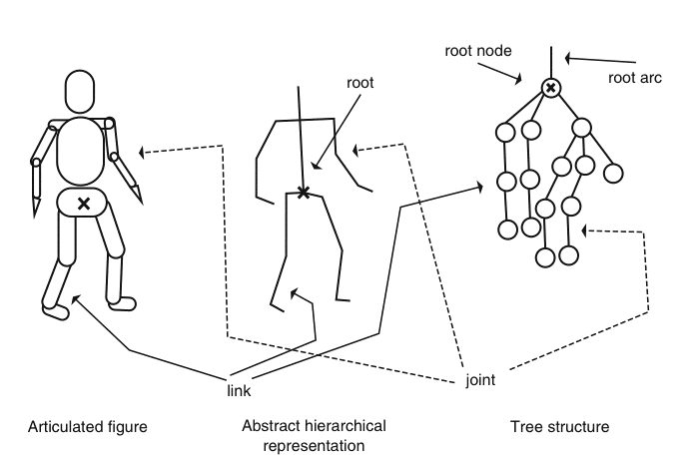
三、Human model
Tree structure

Slide 28
四、关节链结构的运动控制
运动学模型：
结构的运动要受到整体连接性的限制
一个连杆引起其周围的连杆运动，连杆本身具有限制
由于这些限制必须在所有的插值位置上有效，所以不能轻易的使用关键帧系统
设关节链的末端影响器关于世界坐标系的方位为X
关节链结构的状态向量为Θ
X = f (Θ)

Slide 29
四、关节链结构的运动控制
运动学模型：
正向运动学(Forward Kinematics)
通过给定状态向量Θ来确定各关节的位置及末端影响器的位置，正向求解过程；
X = f (Θ)
逆向运动学(Inverse Kinematics)
目标驱动法，给定末端影响器的方位X，然后逆向求解关节链结构的状态向量，进而求得各关节的空间位置，逆向运动学方程可描述为：
Θ = f⁻¹ (X )

Slide 30
四、关节链结构的运动控制
A

Slide 31
1. Forward Kinematics
Θ₂
Θ₁
Θ₃

Slide 32
1. Forward Kinematics
对树结构表示的关节链进行遍历实现运动变换
M = I
T0
M = T0
T1.1
T2.1
M = T0*T1.1*R1.1
R1.1
R2.1
M = T0*T1.1*R1.1*T1.2*R1.2
T1.2
T2.2
M = T0
R1.2
R2.2
M = T0*T2.1*R2.1
M = T0*T2.1*R2.1*T2.2*R2.2

Slide 33
1. Forward Kinematics
二链杆关节链结构的运动过程：
正向运动的解：

Slide 34
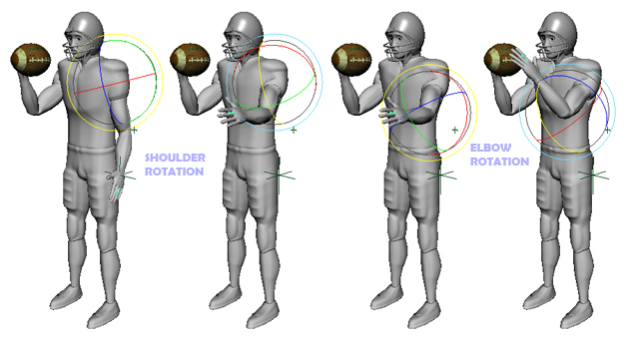
1. Forward Kinematics
求解过程直观简单
需要制作者清晰定义关节结构中每个部件的所有运动
过程比较繁琐，太多的自由度使用户无所适从

Slide 35
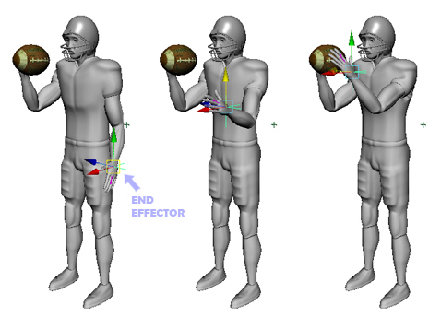
2. Inverse Kinematics
只给定末端影响器的空间方位，反求出整个状态向量
用户的交互非常简便

Slide 36
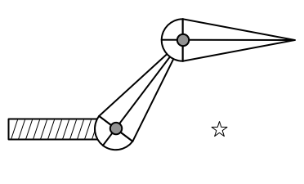
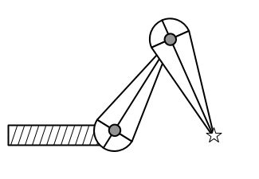
2. Inverse Kinematics
Given
Root transformation
Initial configuration
Desired end point location
Find
Interior parameter settings

Slide 37
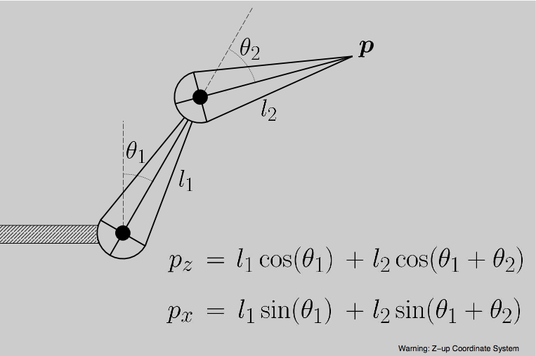
2. Inverse Kinematics
A simple two segment arm in 2D

Slide 38
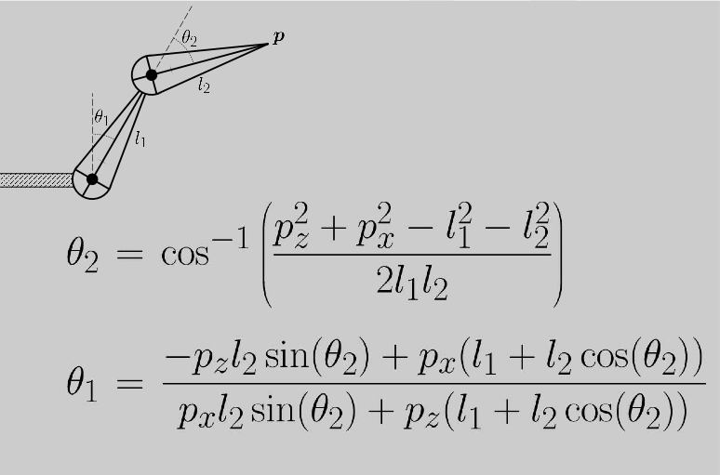
2. Inverse Kinematics
Direct IK: solve for the parameters

Slide 39
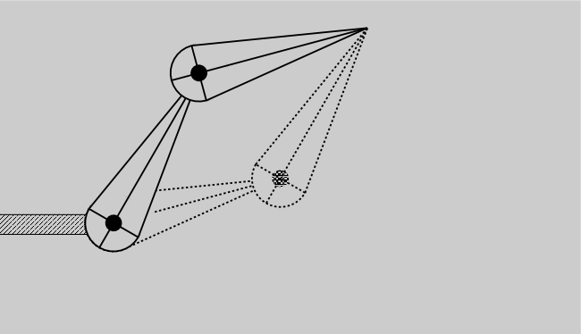
2. Inverse Kinematics
Why is the problem hard?
Multiple solutions separated in configuration space

Slide 40
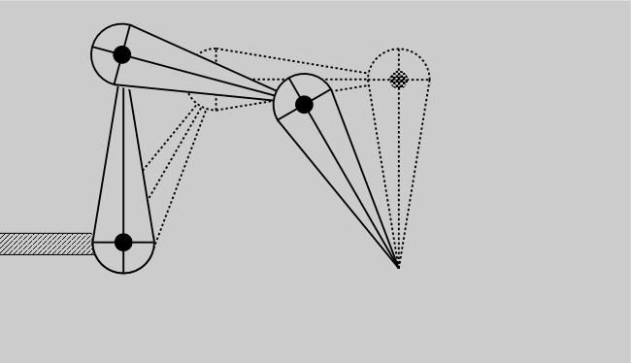
2. Inverse Kinematics
Why is the problem hard?
Multiple solutions connected in configuration space

Slide 41
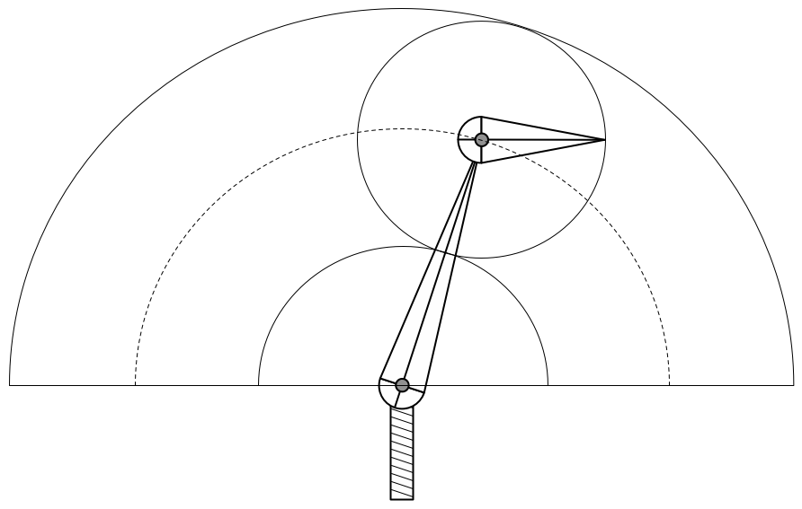
2. Inverse Kinematics
Why is the problem hard?
Solutions may not always exist

Slide 42
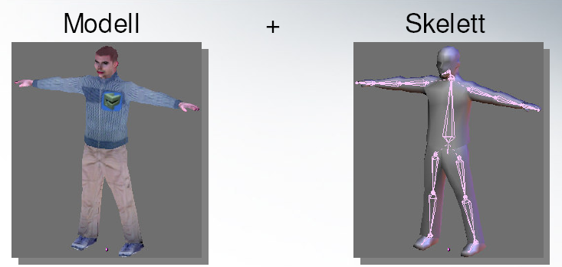
五、Skeletal Animation
Pieces
Skeleton
Bones
Mesh
Materials
Mapping from skeleton to mesh

Slide 43
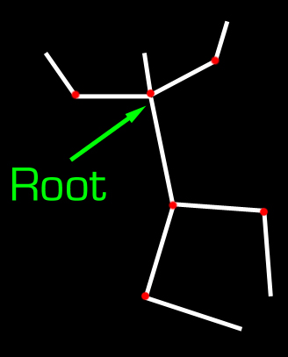
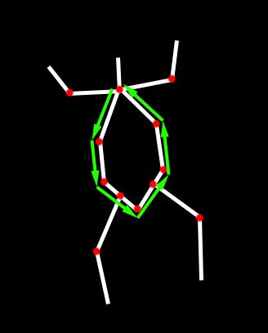
五、Skeletal Animation
Skeletal bones
Connected in a tree
No cycles
No multiple parents
Length and rotation

Slide 44
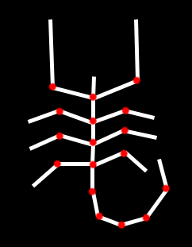
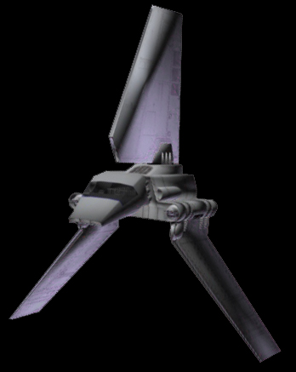
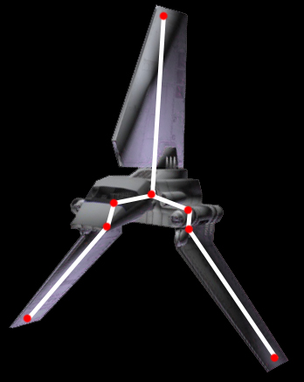
五、Skeletal Animation
Other uses
Not just biped characters
Doors, levers, etc

Slide 45
Content
Keyframing
Skeletal Animation
Motion capture
Motion Editing
Summary

Slide 46
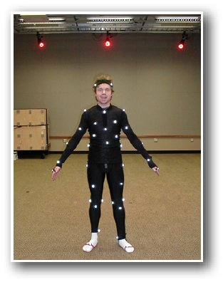
一、Types of Systems
• Optical systems
• Magnetic systems
• Motion tapes
• Inertial and ultrasonic systems
Notes:
Inertial：惯性

Slide 47

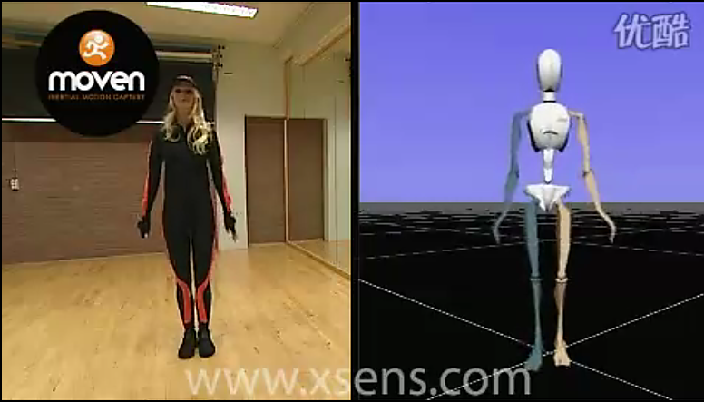
Demo

Slide 48
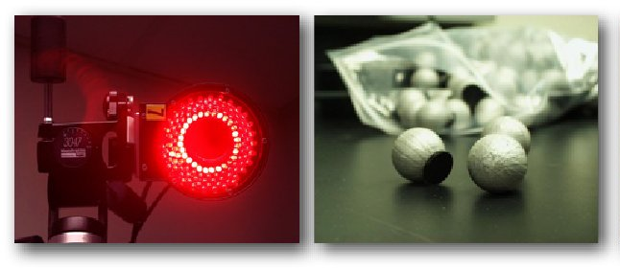
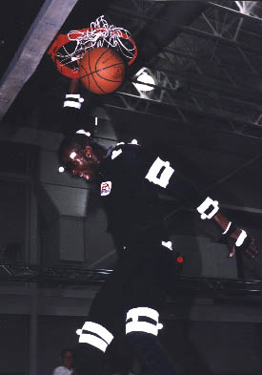
1. Optical systems
Cameras
High temporal resolution (120+ fps)
Detect the locations of reﬂective markers
Markers
Sensitive to infrared

Slide 49
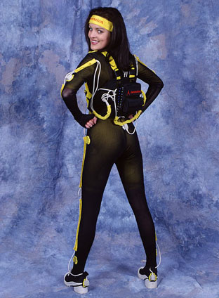
2. Magnetic system
Cumbersome sensors (heavier and also wired)
Smaller workspace
Record both position and orientation
Lower resolution (80 fps max)
Sensitive to EMI/metal in the environment

Slide 50
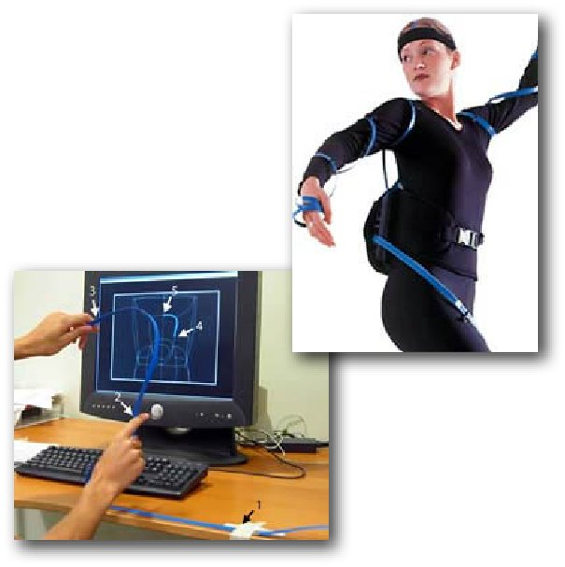
3. Motion tapes
Contain optical ﬁbers and sensors that can detect the bending and twisting
Restriction of movement
Need another technology for detecting root translation
Measure the shape of surface precisely

Slide 51
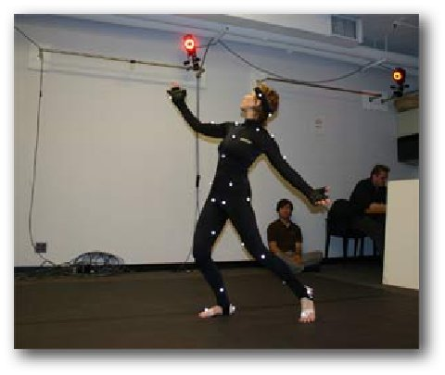
4. Ultrasonic + Inertial
A wearable self-contained system
Inertial information is provided by gyroscopes and accelerometers
Microphones are used to record the distance between each pair of sensors
Notes:
gyroscopes：陀螺仪

Slide 52
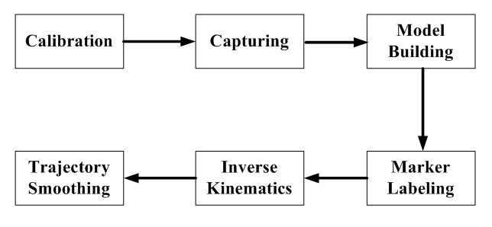
二、Motion capture pipeline

Slide 53
二、Motion capture pipeline
Calibration

Slide 54
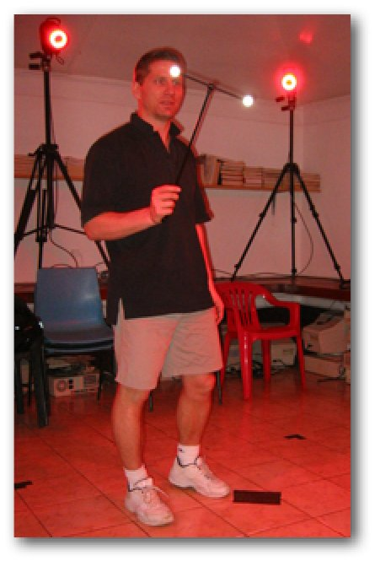
Calibration
Static calibration
Figure out where the ﬂoor is
Dynamic calibration
Figure out the capture volume

Slide 55
二、Motion capture pipeline
Capturing

Slide 56
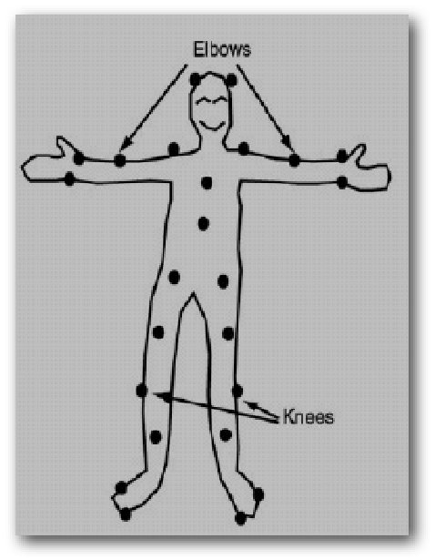
Capturing
Marker placement
Markers should move rigidly with joints
Asymmetric placement helps in post-processing
T-pose and joint exercises
Recording speciﬁc poses can help estimating bone lengths

Slide 57
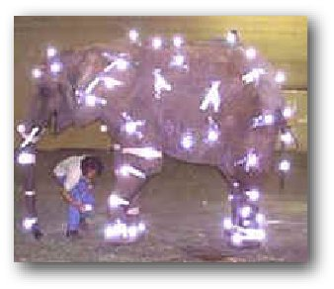
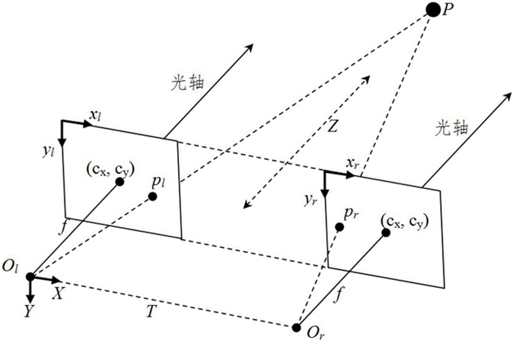
3D marker position
In principle, two cameras are sufﬁcient to reconstruct the 3D location of a object
In practice, more cameras can
reduce occlusion
increase precision

Slide 58
二、Motion capture pipeline
Model
Building

Slide 59
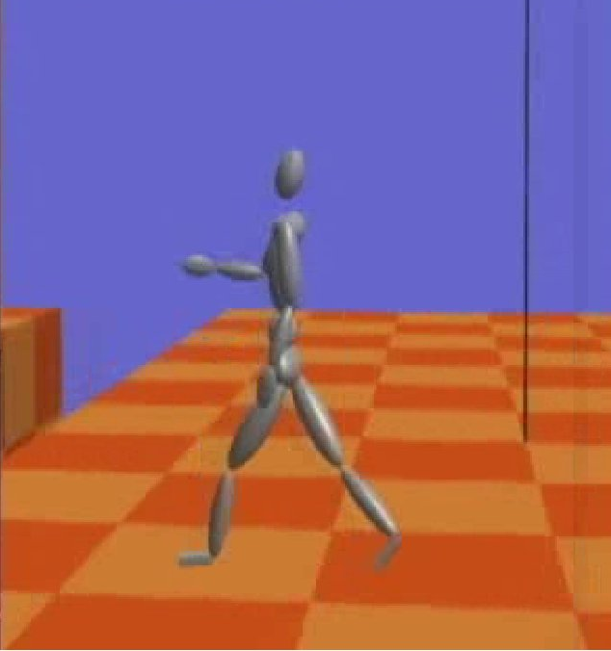
Model building
Given recorded marker positions, estimate the dimension of each body part
Optimize both bone length and handle at the same time
Templates and heuristics help

Slide 60
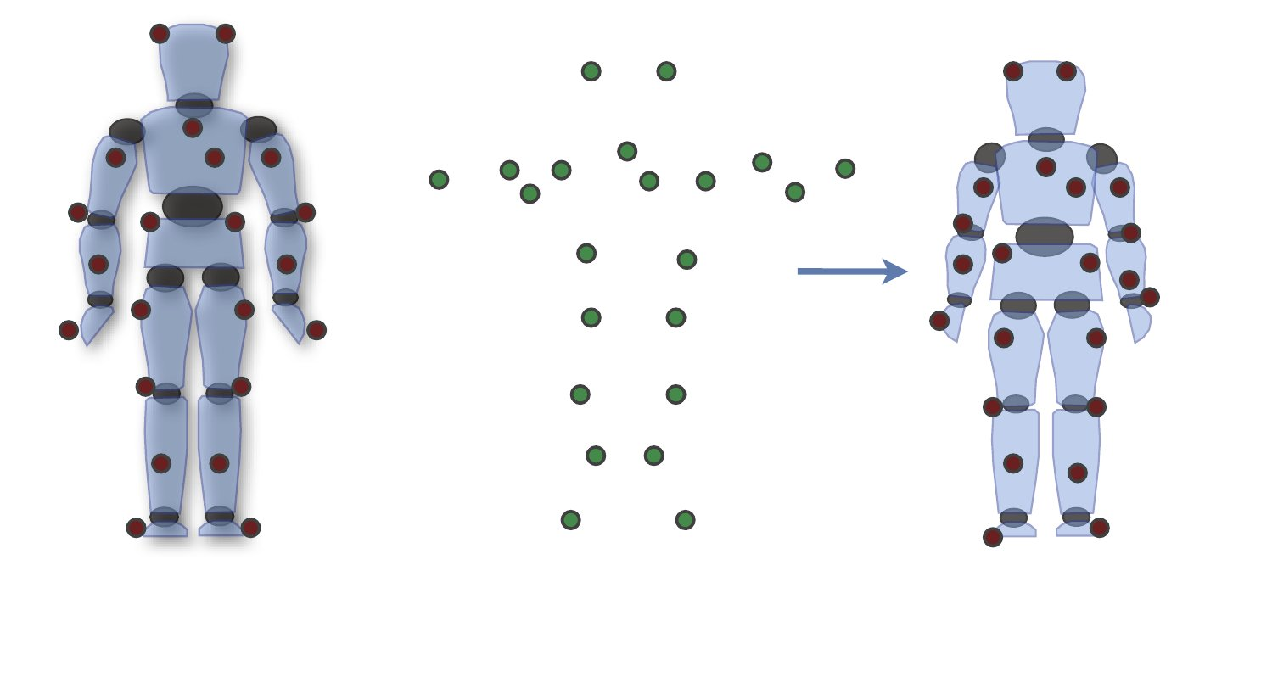
Problem statement
+
generic skeleton
rough handle positions
speciﬁc pose used
for calibration
bone length
handle offset

Slide 61
二、Motion capture pipeline
Marker
Labeling

Slide 62


Marker labeling
Ghost markers
Missing markers
Switching trajectories
3D locations of markers

Slide 63
二、Motion capture pipeline
Inverse
Kinematics

Slide 64

Inverse kinematics
Input: articulated body with handles + desired handle positions
Joint angles that move handles to desired positions

Slide 65
二、Motion capture pipeline
Trajectory
Smoothing

Slide 66


Trajectory smoothing
Global optimization that minimizes the velocity of the joint angles while staying as close as possible to the desired handle positions

Slide 67
Content
Keyframing
Skeletal Animation
Motion capture
Motion Editing
Summary

Slide 68

Edit the motions
Animators cannot immediately use motion capture data
The body size of the character is different from that of the human
Penetrations, foot sliding
The style of motions are not cartoon-like
Want to exaggerate some expressions

Slide 69
Edit the motions
Need to edit the location/trajectories of the i.e hand, feet, etc.
Need an efficient way to edit the motions

Slide 70

Overview
Motion Warping
Motion Blending
Dynamic Time Warping
Foot sliding
Inverse Kinematics
Spacetime constraints
Motion Retargeting

Slide 71

1. Motion Warping
Edit the captured motion a little bit so that it satisfies the requirements
Effective for changing the location the hand or the foot passes

Slide 72

Basic idea
Adding offset to the data so the constraint is satisfied

Slide 73



1. Motion Warping
Add an offset to the trajectories to edit the motion
Determine the keyframes, between which the motion should be edited
Edit the inbetween keyframes so that the resulting motion satisfies the requirements

Slide 74
2. Motion Blending
Given two different motions A and B
Blended Motion = A * (1-s) + B *s (0<s<1)
How can we use this?
Generate a motion inbetween
Exaggerating the motions by extrapolation
Gradually shift from motion A to motion B
Concatenating two motions
After motion A, start motion B

Slide 75

Creating a motion inbetween
Generating a new motion by interpolating multiple motions
A cheerful walking motion * s + (1-s) * ordinary walking motion = A little bit cheerful motion
A tired walking motion * s + (1-s) * ordinary walking motion = A little bit tired motion (0 < s < 1)

Slide 76

Exaggerating the motion by extrapolation
Given two different motions A and B
Blended Motion = A * (1-s) + B *s
Set s to values larger than 1, or smaller than 0

Slide 77


Creating a shifting motion by gradually changing s
Create transition motion by shifting s from 0 to 1
Motion A >>> Motion A*(1-s) + B*s >>> Motion B

Slide 78
The problems when blending motions
The durations of motions are different
The timing of some events are different
Suppose we want to blend two walking motions
The timing the feet lands onto the ground are different
We need to synchronize the motions

Slide 79


3. Dynamic Time Warping (DTW)
Synchronizing the motions by finding the most matching frame
Compute the distance of every frame
Create a similarity matrix of all frames
Find the optimal time alignment that minimizes the total distance between matched frame
15

Slide 80

4. Foot Sliding
We usually blend the motions in the level of generalized coordinates ( root position, root orientation and joint angles)
No information about contacts
The supporting foot/feet slides when the motion is simply blended
16

Slide 81

5. Inverse Kinematics
Editing the postures/motions by specifying the 3D location of the avatars
We can use IK to solve the problem of foot sliding
Edit the postures, frame by frame, and drag the foot to the original position
17

Slide 82

6. Spacetime constraints
Instead of editing the motion frame-by-frame, here we edit the whole motion at once
So that the constraints are satisfied
We want the displacement to be small, so minimize the integral of displacement
24

Slide 83

7. Motion Retargeting
Use the captured motion for a character with different body size
Captured motion (adult) >>> for a child character
Need to edit the motion while satisfying the constraints
the support must be landed on the ground,
The segments must not penetrate the other parts of the body
We can use IK/spacetime constraints to solve this problem
25

Slide 84


Demo

Slide 85
运动的重定向技术
指利用已经存在的角色运动数据，经过适当的调整处理，把姿态映射到目标角色模型上，使目标模型具有相似的运动。

Slide 86

一些运动重定向思路
相同关节结构，不同骨骼长度

Slide 87

一些运动重定向思路
不同关节结构

Slide 88

一些运动重定向思路
根据蒙皮信息

Slide 89

一些运动重定向思路
标记与语义性描述语言相结合

Slide 90
Content
Keyframing
Skeletal Animation
Motion capture
Motion Editing
Summary

Slide 91
When to Use What Method?
Keyframing
Sprites and other simple animations
Non-human characters
Coarse collision detection
Motion Capture
Human figures
Subtle motions, long motions
Simulation
Passive simulations
When interactivity / motion is important

Slide 92
Summary
Passive Objects
Active Characters
Simulation
Keyframing
Motion Capture

